Slide 1

Tune Tracer
Treyton Perkins, Jacob Ridenour, Austin Shutt
Treyton Perkins, Jacob Ridenour, Austin Shutt
Notes:
Austin

Slide 2
Outline
What Are We Doing?
Current Progress
Architecture
Audio File To MIDI
MIDI To Sheet Music PDF
Instrument Classification
Approach
Dataset
Data Preparation
Model Structure
Results
Future Ideas
Using The Model In Solution
Demo
What's Been Going Well
What We Can Improve
Future Work

Slide 3
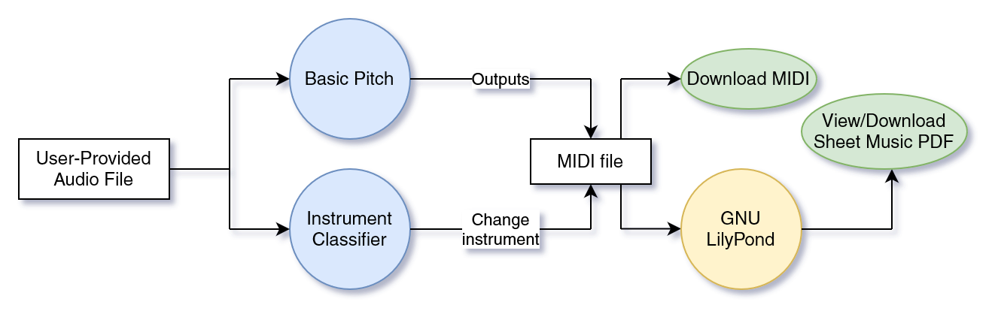
What Are We Doing?
Turn audio files into an appropriately-instrumented MIDI
Basic Pitch generalizes across instruments
Get PDF sheet music for your MIDI

Slide 4
Current Progress
(Very) Basic UI
Upload audio files
Convert audio to MIDI with Basic Pitch
Convert MIDI to sheet music PDF with GNU LilyPond
Instrument Classifier

Slide 5
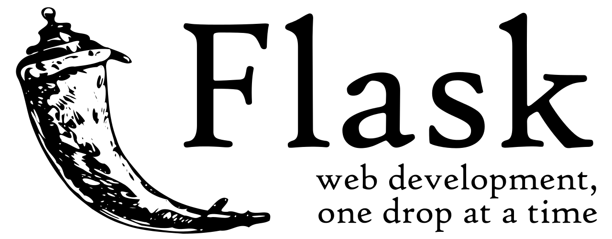
Architecture
Frontend: simple HTML and JavaScript
Backend: Flask (Python Web framework)
Model Development: Jupyter notebook
Colab or local development

Slide 6

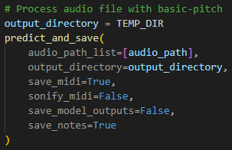
Audio File to MIDI
Using Basic Pitch Python library
Utilizes Spotify’s Basic Pitch neural network
MIDIs output to temp file based on UUID
Available for Download once conversion complete

Slide 7
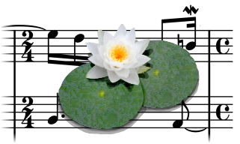
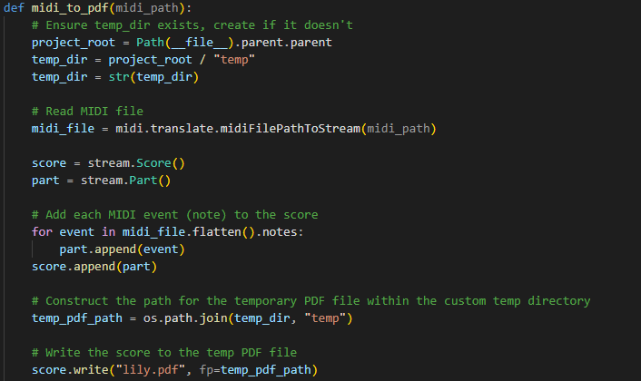
MIDI to Sheet Music PDF
Interpret MIDI data using music21 library
Convert to PDF using GNU LilyPond

Slide 8
Instrument Classification - Dataset
IRMAS Dataset For now(3gb), NSYNTH Later(90gb)?
Classes [11]: Cello, Clarinet, Flute, Guitar(Acoustic), Guitar(Electric), Organ, Piano, Saxophone, Trumpet, Violin, Voice
Training Data
6705 .wav files (3 second) (44.1kHz) Single Instrument Data
Not homogenous across classes
Test Data
Very Different Format from Training Data
Variable Length
Multi-Class Labels

Slide 9
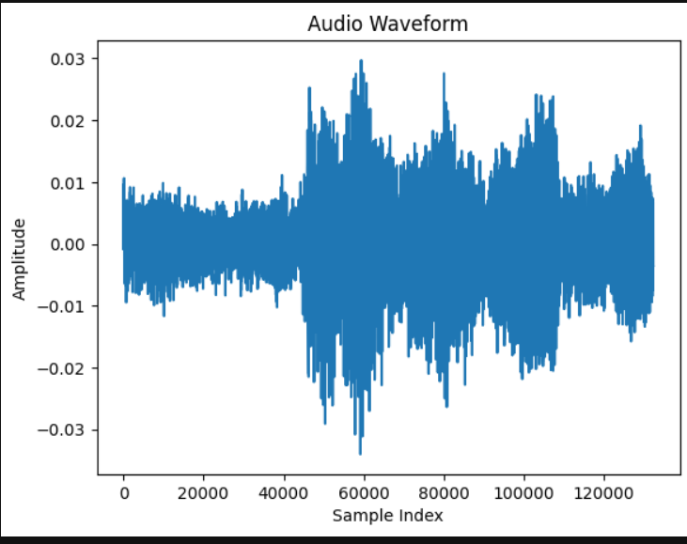
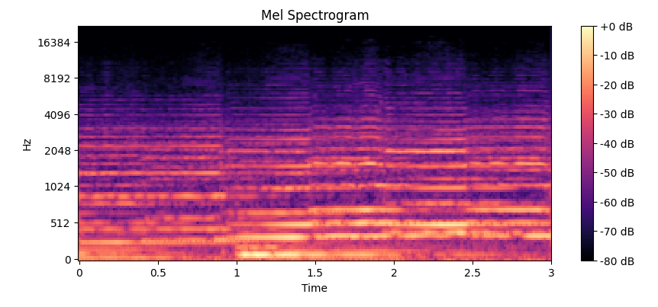
Instrument Classification - Data Preparation
Librosa conversion of .wav file to spectrogram. Example:

Slide 10
Instrument Classification - Data Preparation
Normalization:
# Calculate mean and standard deviation of the spectrogram data
mean = np.mean(X_train_spectrograms)
std = np.std(X_train_spectrograms)
# Normalize the spectrogram data using mean and standard deviation
X_train_spectrograms_normalized = (X_train_spectrograms - mean) / std
One Hot Encoding:
y_train_one_hot = to_categorical(y_train, num_classes)

Slide 11
Instrument Classification - Model Structure
Convolutional Neural Network Model (CNN)
model = models.Sequential([
layers.Conv2D(32, (3, 3), activation='relu', input_shape=input_shape),
layers.MaxPooling2D((2, 2)),
layers.Conv2D(64, (3, 3), activation='relu'),
layers.MaxPooling2D((2, 2)),
layers.Conv2D(128, (3, 3), activation='relu'),
layers.MaxPooling2D((2, 2)),
layers.Flatten(),
layers.Dropout(rate=0.5),
layers.Dense(64, activation='relu'),
layers.Dense(num_classes, activation='softmax')
])

Slide 12
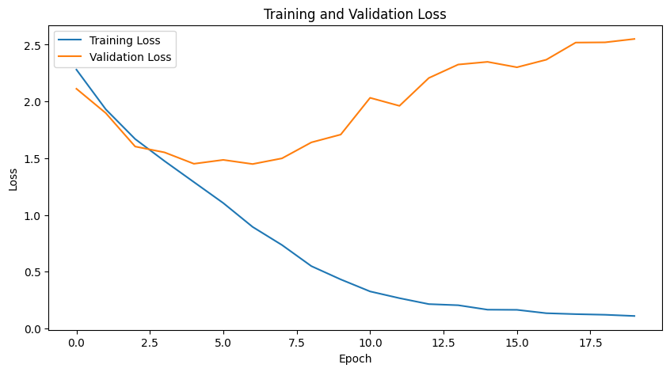
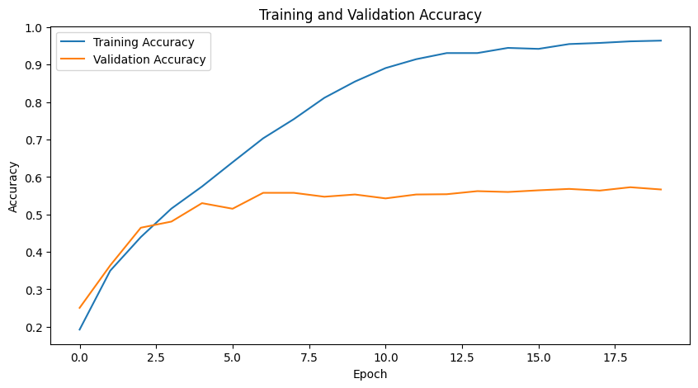
Instrument Classification - Results
Baseline Accuracy: 9%
Peak Validation Accuracy: 56%
Optimal # of Epochs: ~ 7
Training Time: ~ 6.5 min/Epoch
Issue with provided Test Data

Slide 13
Instrument Classification - Future Ideas
Homogenize the number of samples across all the classes
Increase the number of layers
Augment Dataset - switch left/right channels of stereo data
Increase dataset size (nsynth)(90gb)[Modified Approach]

Slide 14
Instrument Classification - Using the Model in Soln
Sample 4
Sample 3
Sample 2
Sample 1
Music Clip
0
1
2
3
4
5
6
Seconds
Approach: Split the audio in to multiple 3 second increments, then keep a count of predictions for each instrument, select the highest as ultimate prediction.

Slide 15
Demo
Notes:
Austin

Slide 16
What’s been going Well
Project architecture & organization have been kept simple
Platform agnostic: works on Windows and Linux
Communication and work done
Despite a very busy semester!

Slide 17
What We can Improve
Nicer GUI utilizing JavaScript and CSS/Bootstrap
Learning curve for working with audio compared to images
Earlier and more frequent commits and pull requests

Slide 18
Future Work
Fully Integrate instrument classifier model
Process audio simultaneously with Basic Pitch to identify an instrument
Modify Basic Pitch’s MIDI output to reflect the identified instrument
Refine and improve model
Current models peak around 70% accuracy
Revamp Front-End
Utilize CSS and JavaScript
Potentially implement Bootstrap
Extra features
Add the ability to record audio in the browser

Slide 19
Q/A
Any questions?

